Slide 1
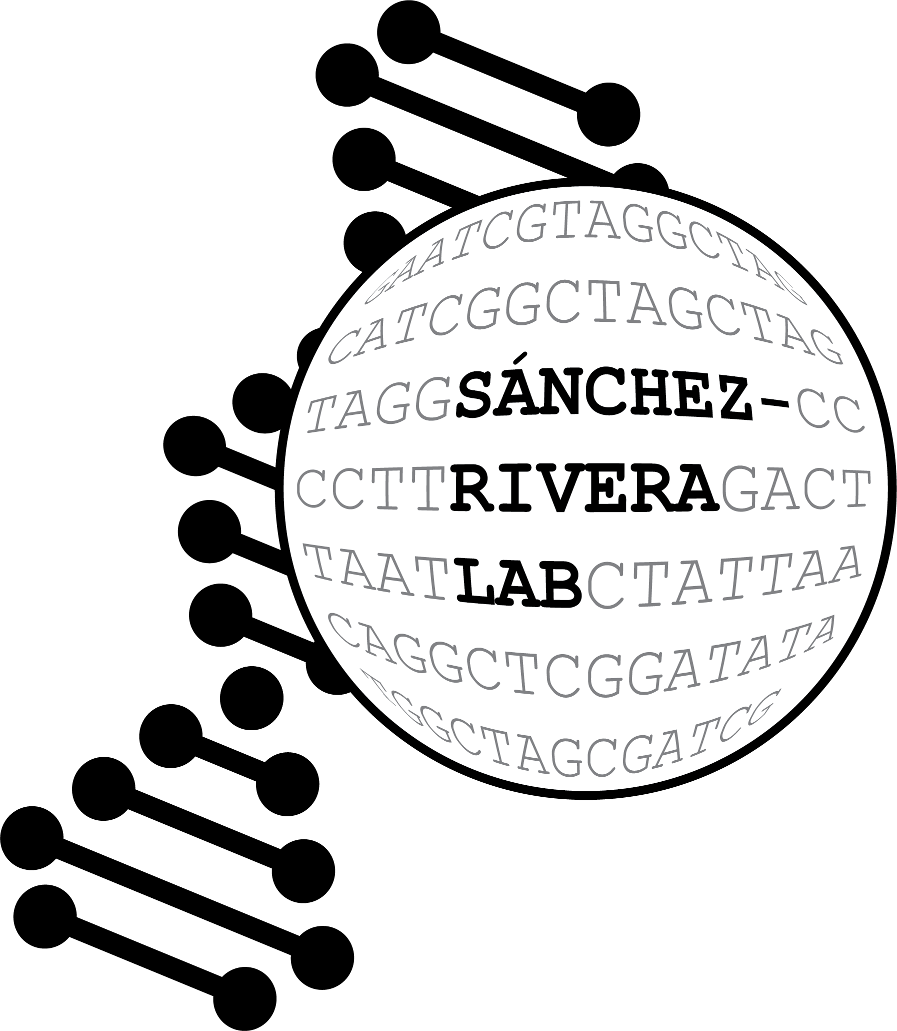
A tiling base editing library of the FGFR2-IIIb-OPTN fusion
Sam Gould

Slide 2
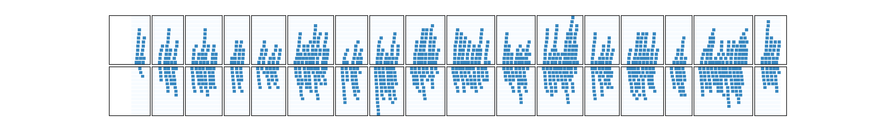
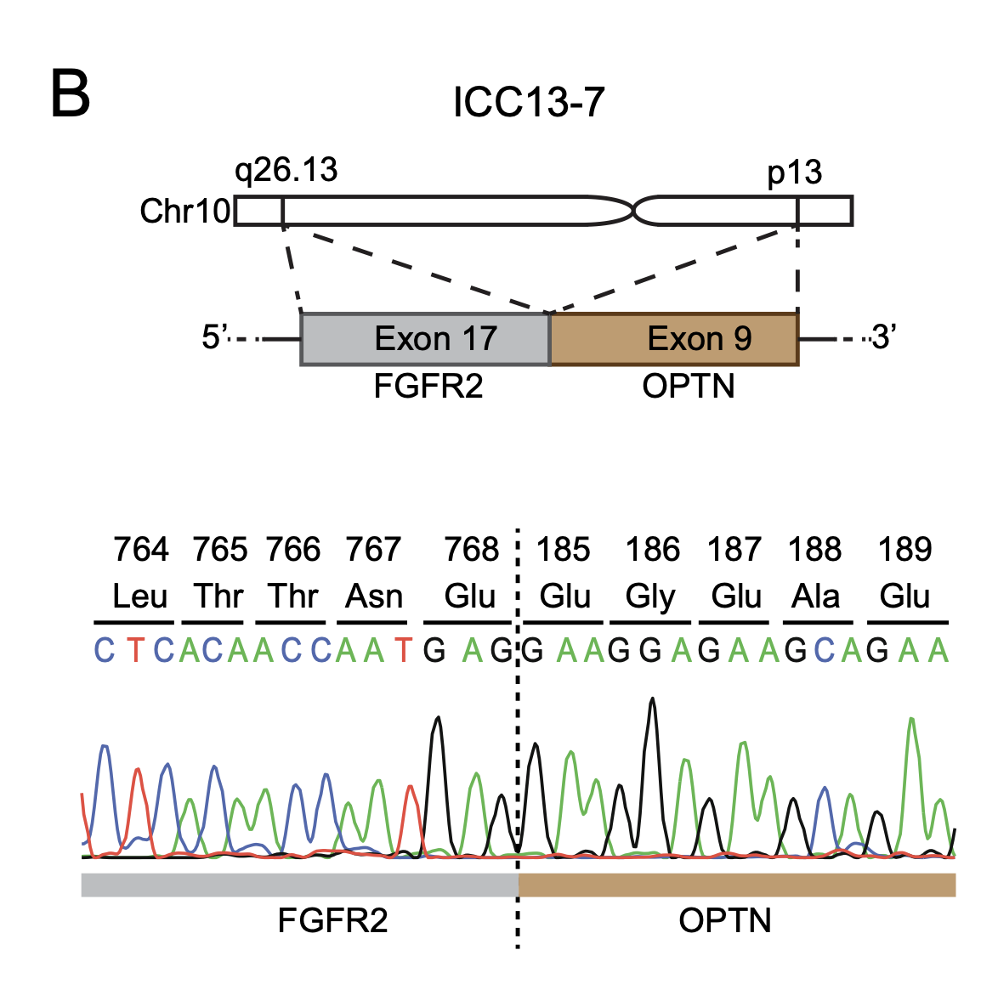
A tiling base editing library of FGFR2-IIIb (for the FGFR-OPTN fusion)
Exon:
1
2
3
4
5
6
7
8
9
10
11
12
13
14
15
16
17
+
–
Generating all possible NG protospacers
Using FGFR2-IIIb transcript
Filtered gRNAs that target area beyond the breakpoint
N = 1,252 gRNAs
Does not include control gRNAs that would be added
Non-targeting gRN As
Intron-targeting gRNAs
Relatively small library
1000X representation = 1.25 MM cells

Slide 3
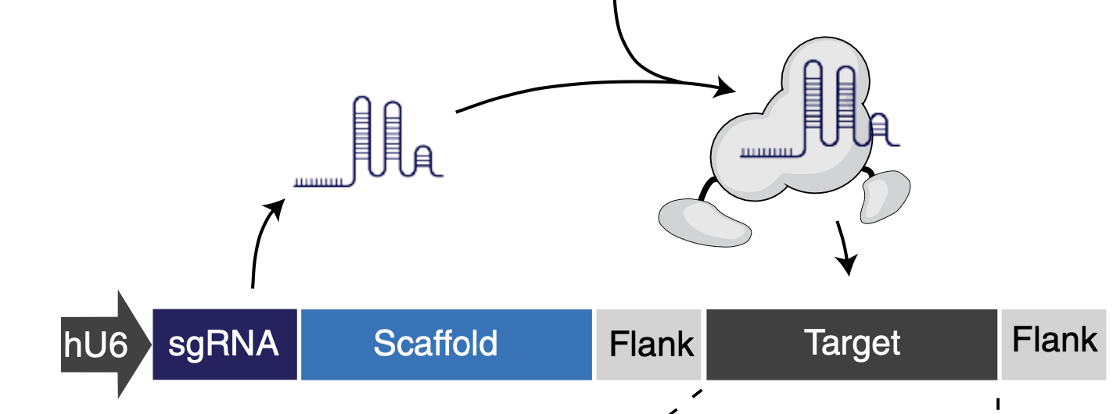
Using the base editing sensor platform to readout guide editing activity and abundance simultaneously.
WT
GATCAGTACATCGTAGCATGGCTAGACTA
Quantify %
via
NGS
Correct Edit
GATCAGTACATCGTAGTATGGCTAGACTA
Indel
GATCAGTACATCGTAG--TGGCTAGACTA

Slide 4
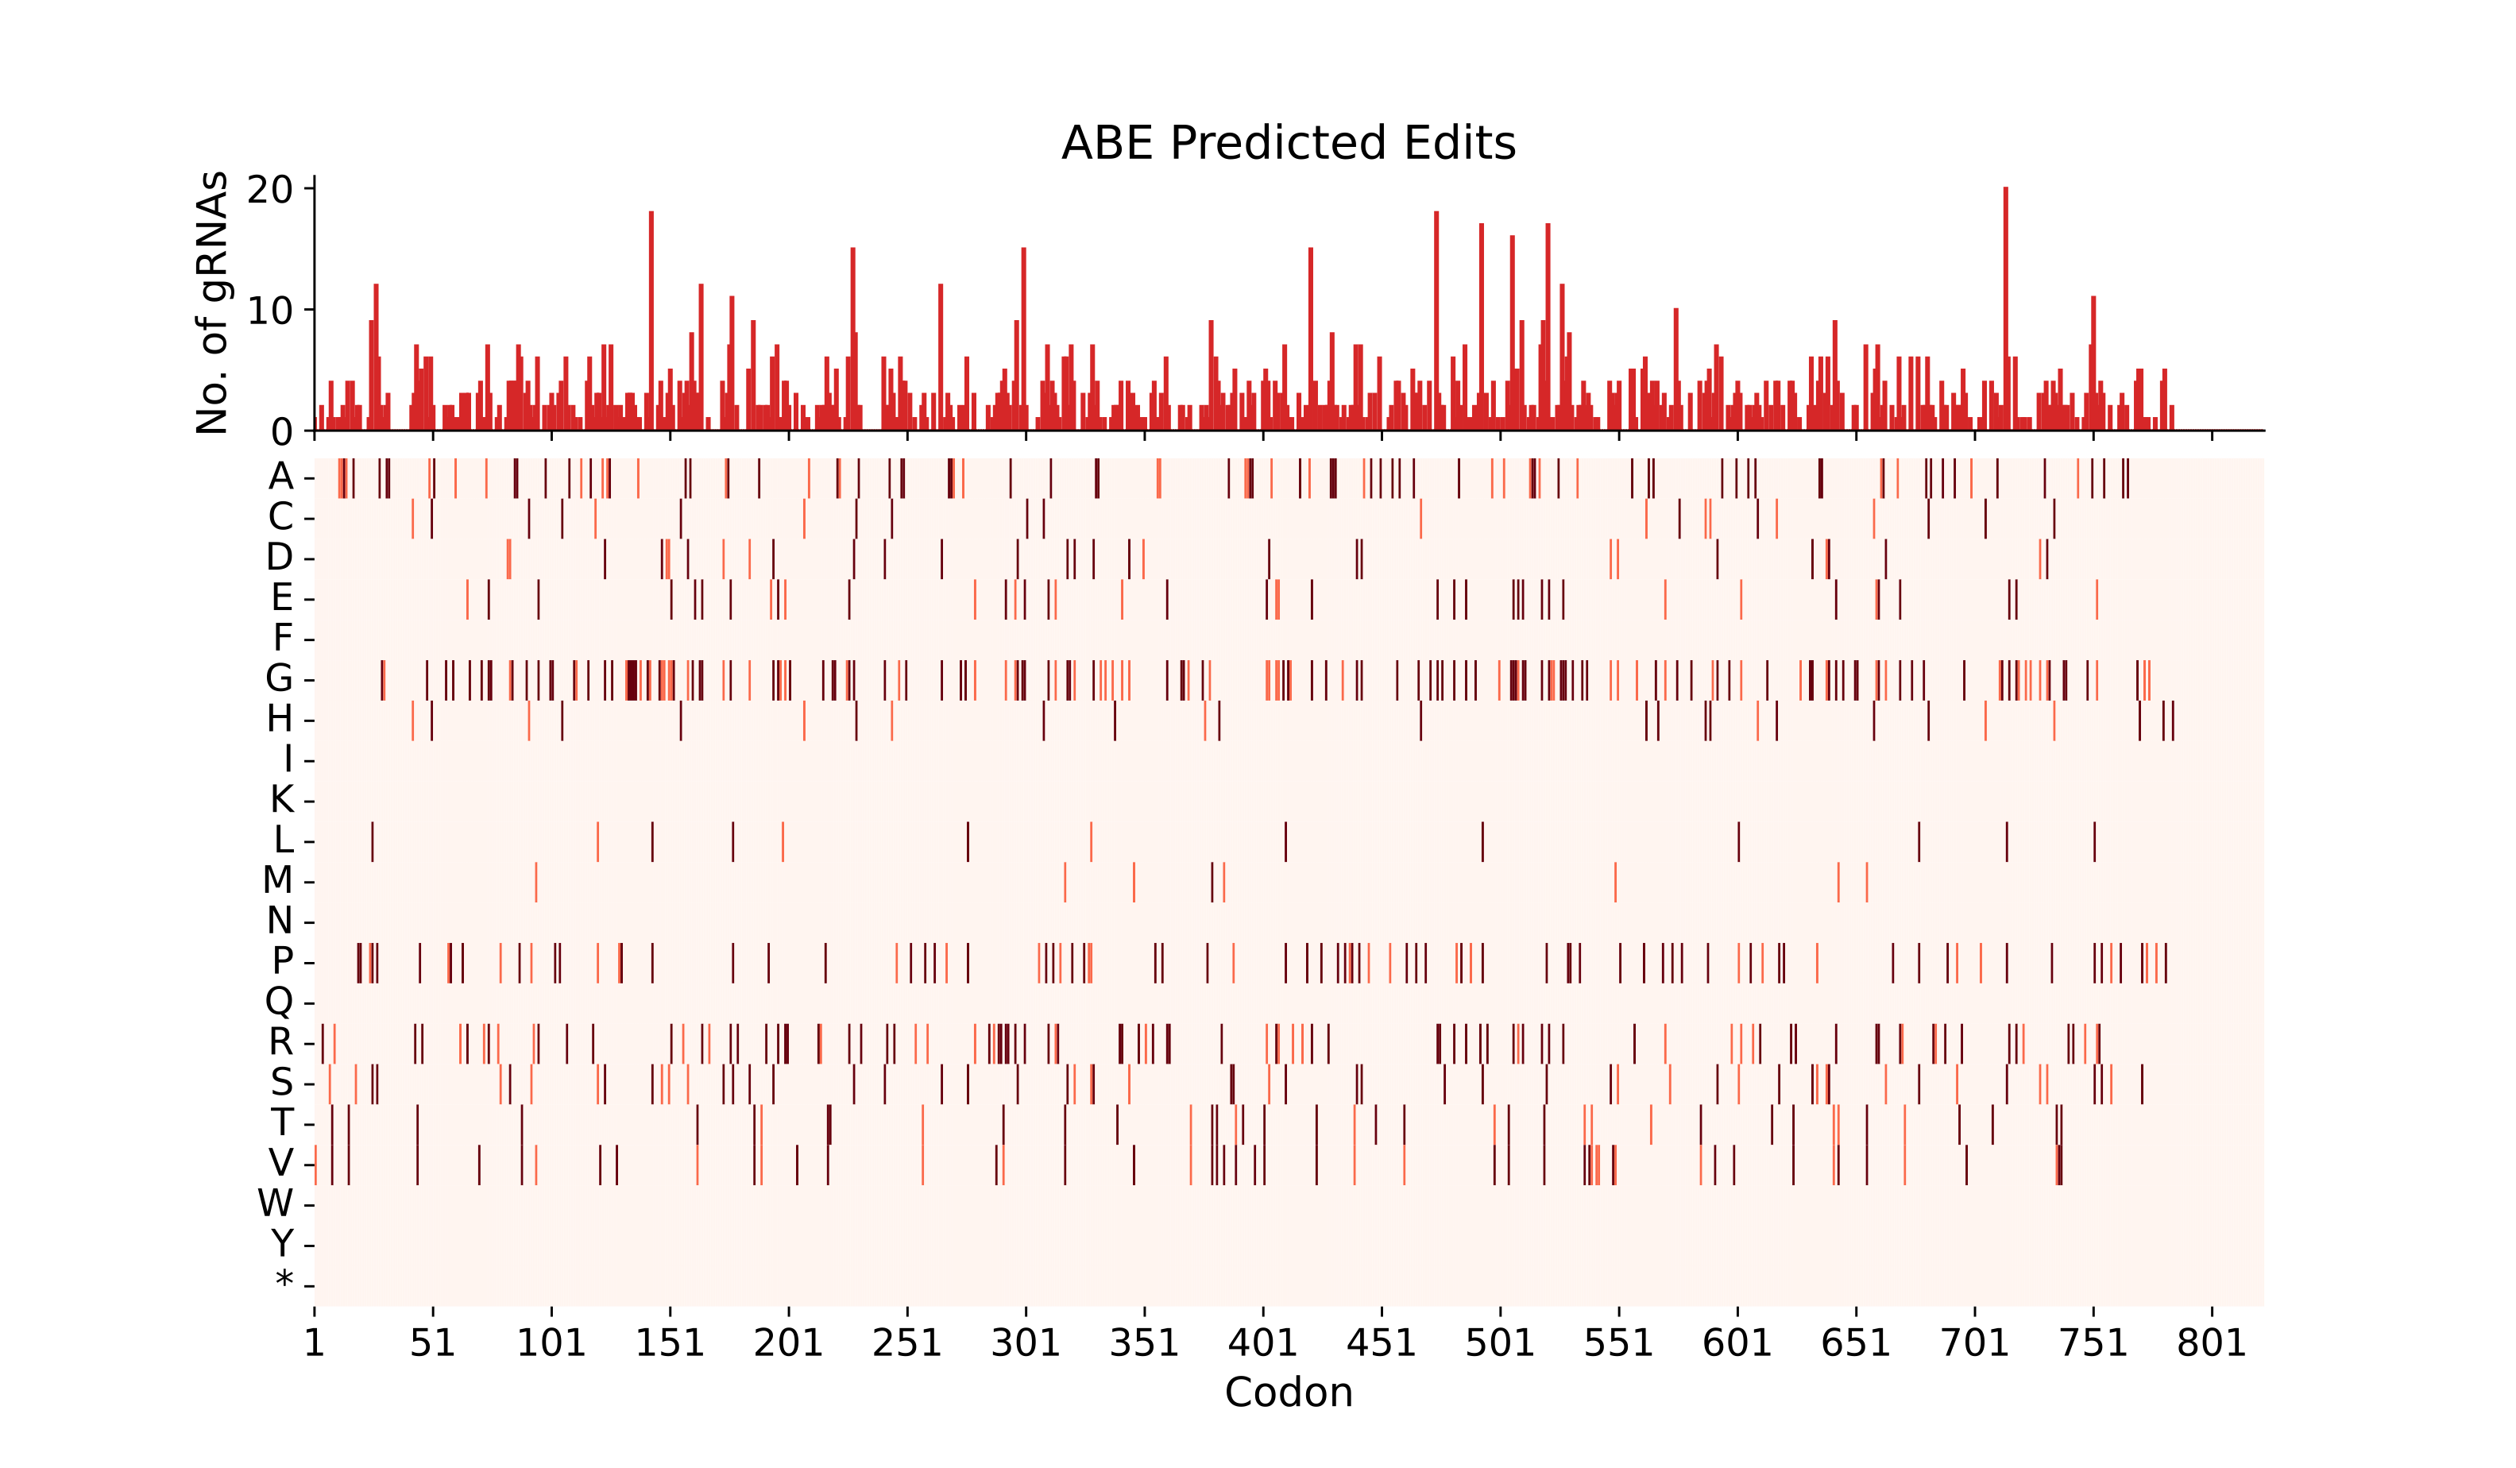
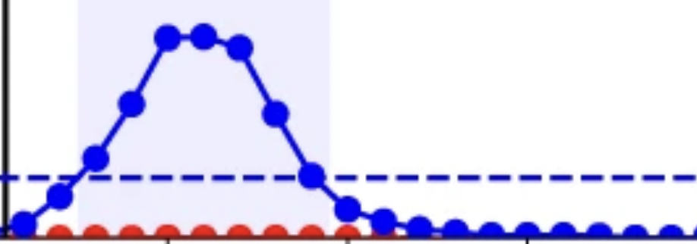
We can target nearly all residues in FGFR2-IIIb through both CBE-NG and ABE-NG
*Predicting all possible editing outcomes based on ideal editing window in +4 to +8 region of protospacer
Example:
Editing Efficiency
+4
+8
sgRNA
AGACATAGTTTCCTGAGCAATG
H
S
DNA
Protein
WT
CATAG
HS
CGTAG
RS
ABE
CATGG
HG
CGTGG
RG
CBE
TATAG
CS

Slide 5
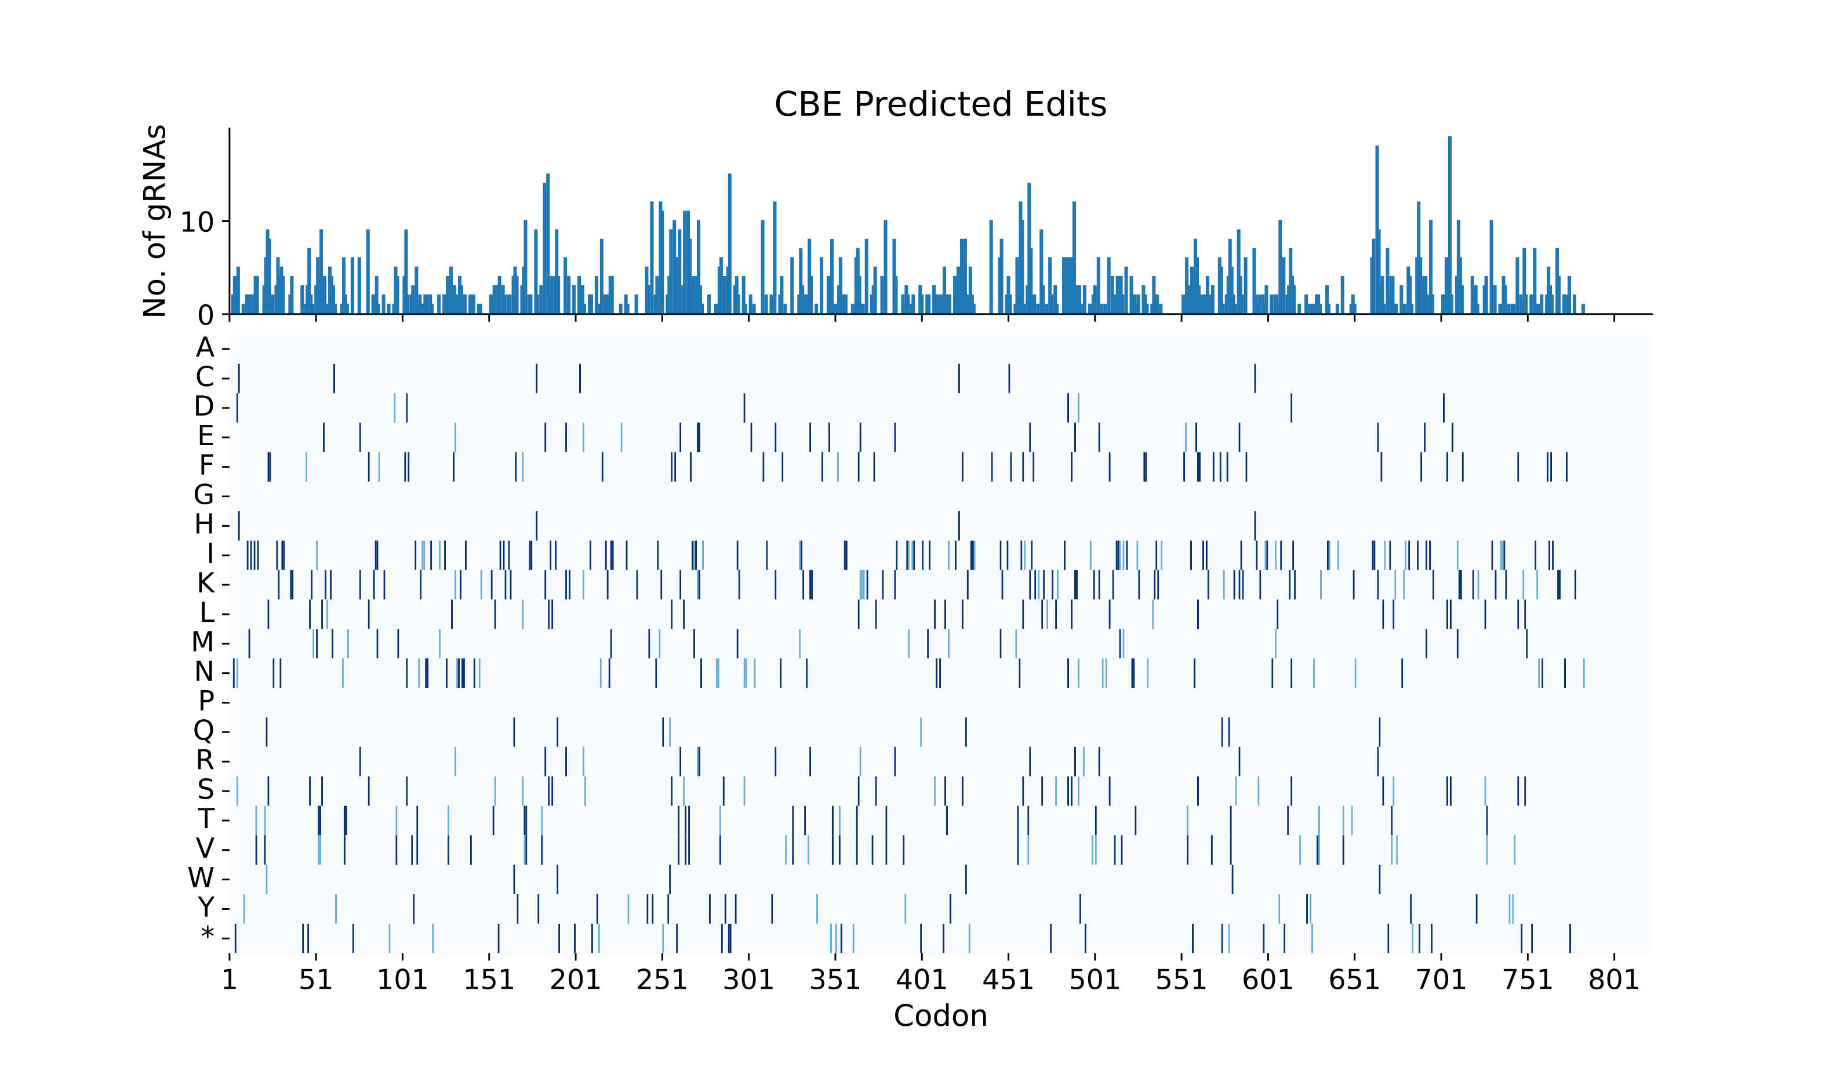
We can target nearly all residues in FGFR2-IIIb through both CBE-NG and ABE-NG
*Predicting all possible editing outcomes based on ideal editing window in +4 to +8 region of protospacer
Example:
Editing Efficiency
+4
+8
sgRNA
AGACATAGTTTCCTGAGCAATG
H
S
DNA
Protein
WT
CATAG
HS
CGTAG
RS
ABE
CATGG
HG
CGTGG
RG
CBE
TATAG
CS

Slide 6
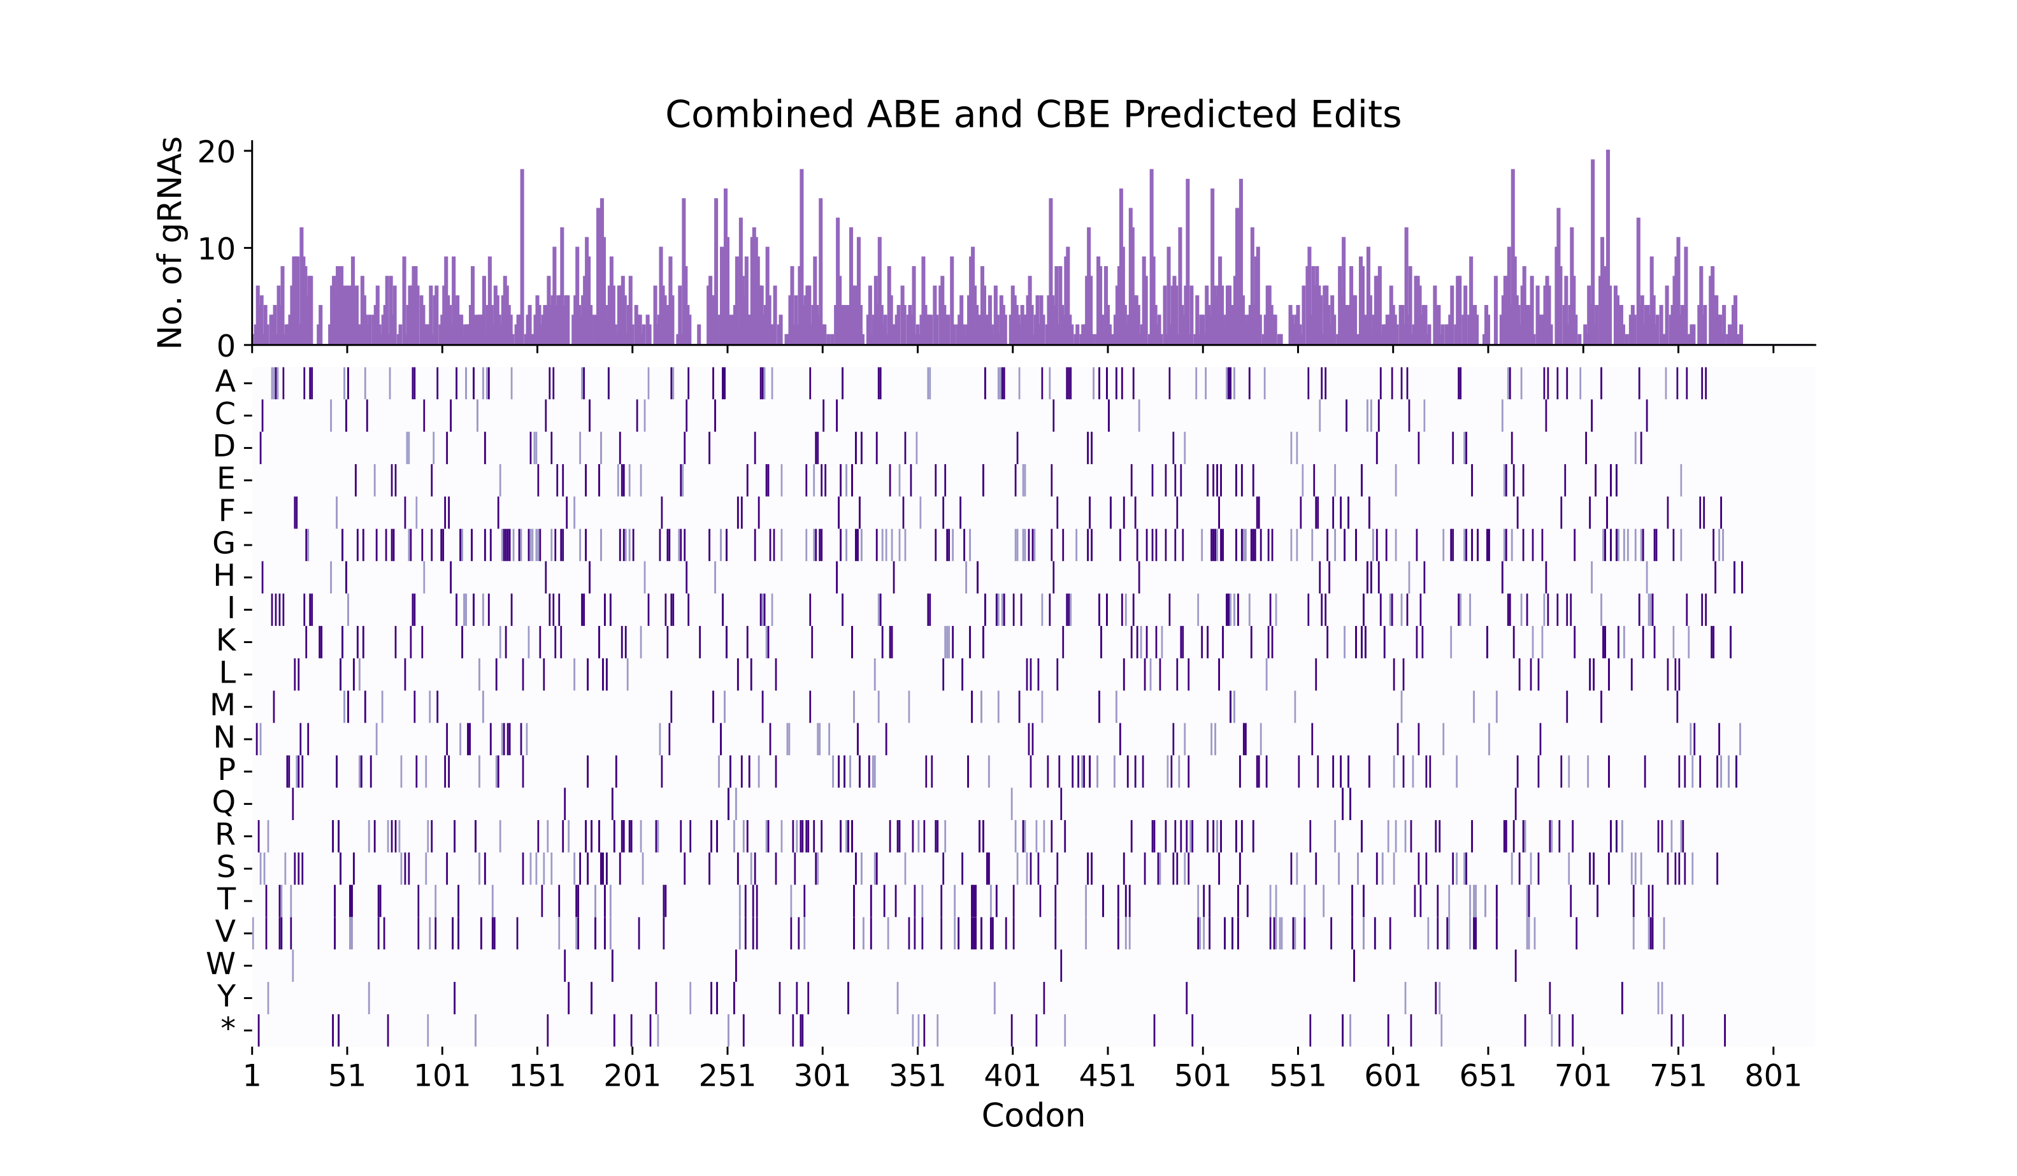
We can target nearly all residues in FGFR2-IIIb through both CBE-NG and ABE-NG
*Predicting all possible editing outcomes based on ideal editing window in +4 to +8 region of protospacer
Example:
Editing Efficiency
+4
+8
sgRNA
AGACATAGTTTCCTGAGCAATG
H
S
DNA
Protein
WT
CATAG
HS
CGTAG
RS
ABE
CATGG
HG
CGTGG
RG
CBE
TATAG
CS

Slide 7
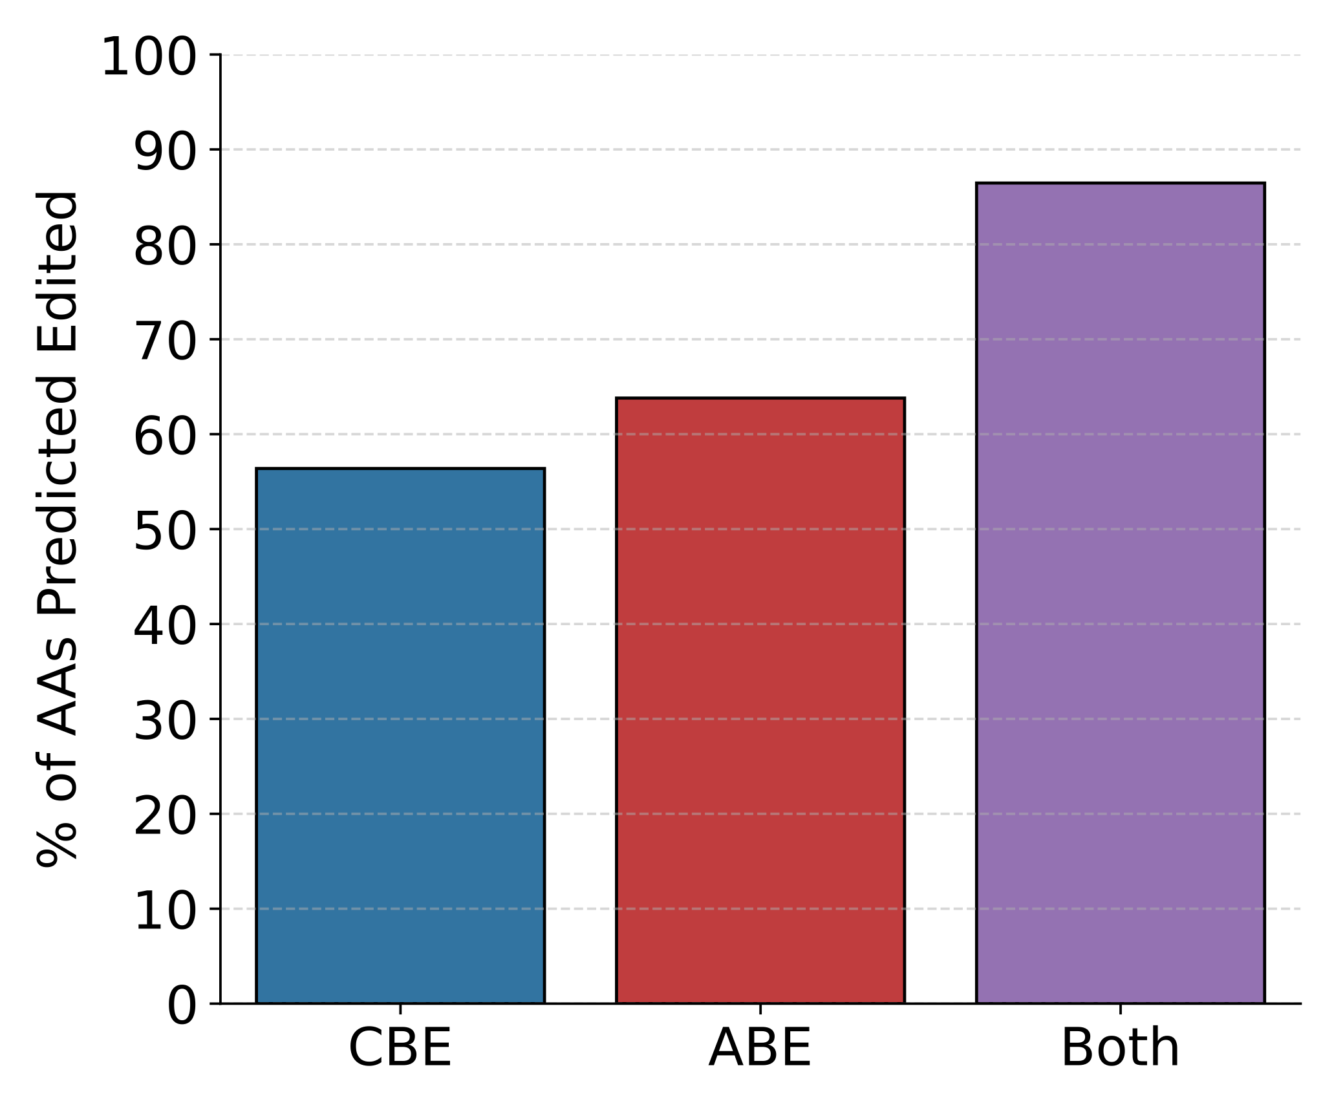
We can target nearly all residues in FGFR2-IIIb through both CBE-NG and ABE-NG
86.5%
63.8%
56.4%

Slide 8
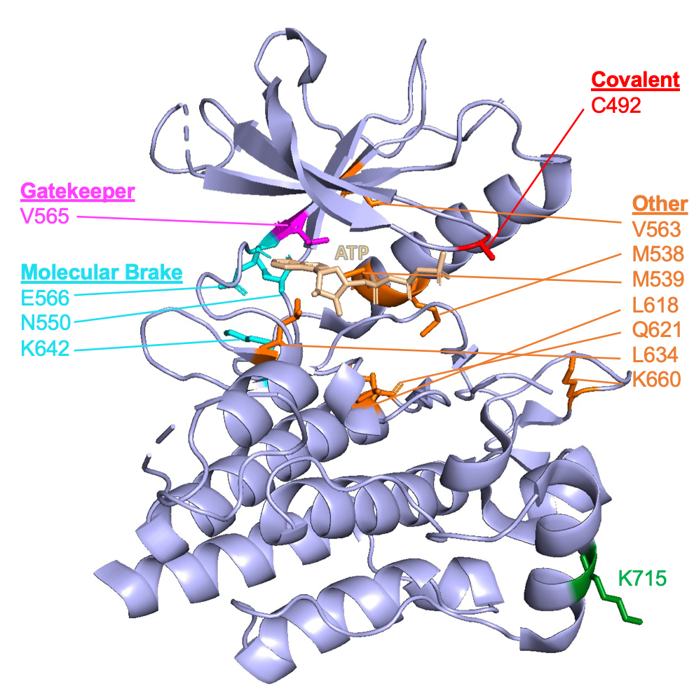
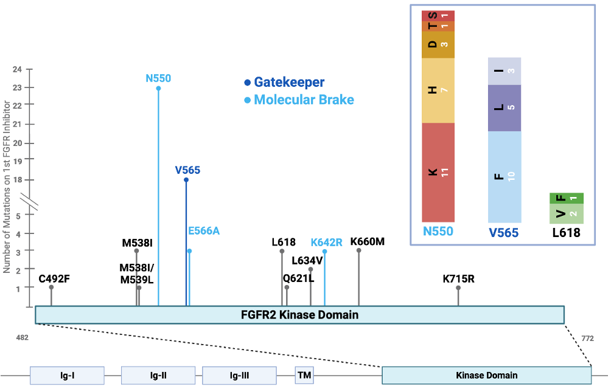
Clinical Kinase Domain Mutations
Base editing should be able to target nearly all of the residues that are observed to be mutated in patients.
A568Y | L618V
C492C | L634V
D651H | M537I/M538L
D651Y | M538I
E566A | M539L
E566G | N550D
G543R | N550H
I549T | N550K
K527E | N550T
K642R | Q621L
K660M | S569F
K660N | V565E
K660Q | V565F
K715R | V565I
L551F | V565L
L618F | V565Y
L618M
Codon | ABE Edit 1 | ABE Edit 2 | ABE Edit 3 | CBE Edit
492 | C492R |  |  | C492Y
538 | M538V
539 | M539T | M539V |  | M539I
550 | N550D | N550G | N550S
565 | V565A |  |  | V565I
566 | E566G |  |  | E566K
618 | L618P | L618S
621 | N/A |  |  | N/A
634 | L634P | L634S
642 | K642E | K642G | K642R
660 | K660E | K660G | K660R
715 | K715E | K715G | K715R
*Table shows predicted amino acid changes at these codons

